Slide 1
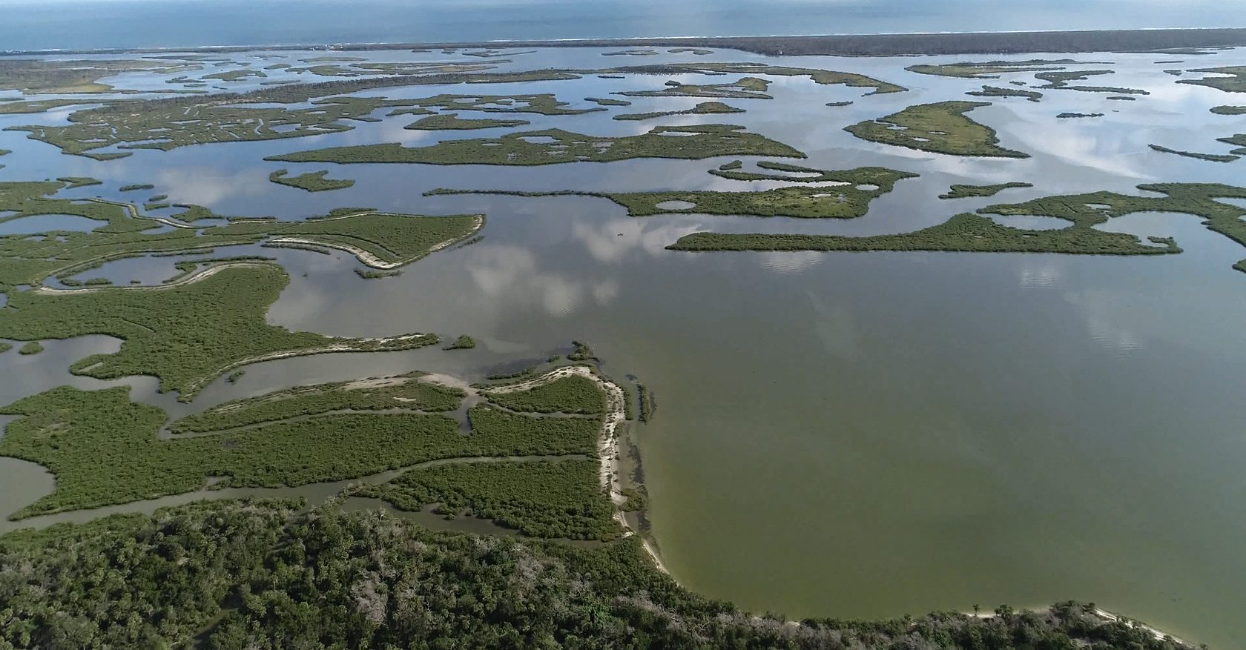
UAV/Drone GIS processing
Dr. Bo Yang
Bo.Yang@ucf.edu
CitizenScienceGis.org
Department of Sociology, University of Central Florida;
Citizen Science GIS, University of Central Florida

Slide 2
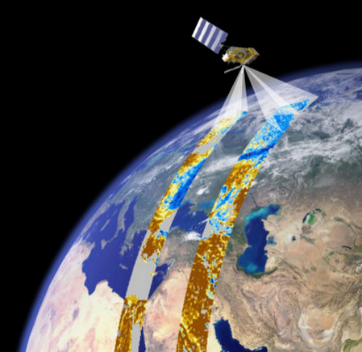
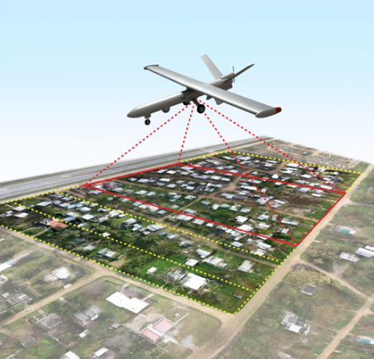
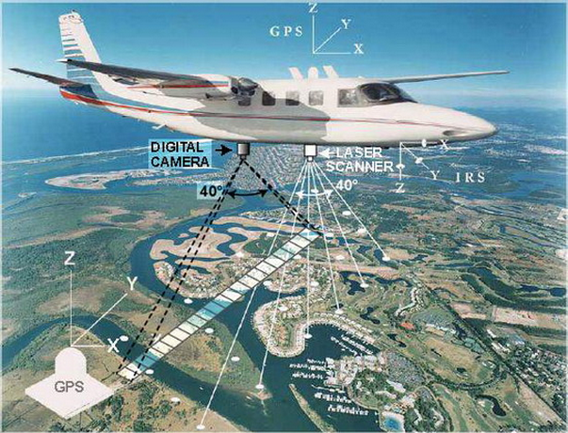
Types of remote sensing data
Introduction
Satellite remote sensing
Aerial remote sensing
UAV remote sensing
Notes:
On the other hand, remote sensing data can obtain an image,
Meanwhile there is a trade-off between spatial and temporal resolution.
For example, Landsat have 30m spatial resolution but 16 day revisiting cycle,
MODIS have daily frequency. But the spatial resolution is relatively low.

Slide 3
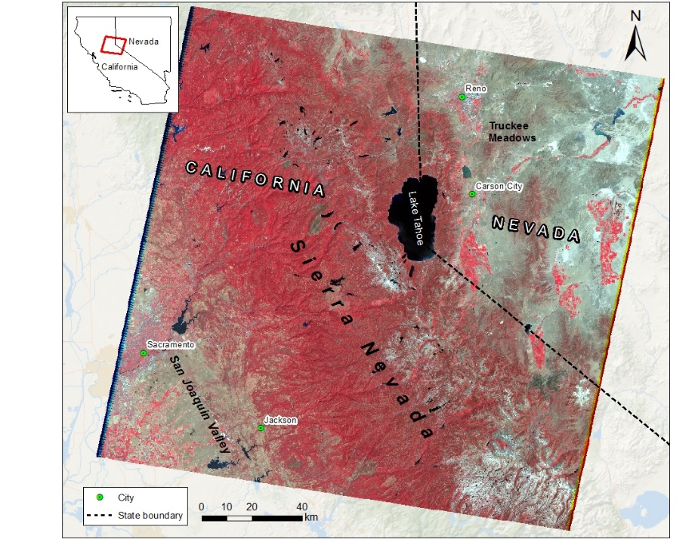
Satellite remote sensing
Introduction
Pros
Temporal revisiting cycle, historical data
Easier to obtain
Multi-spectral data
Cons
Moderate spatial resolution
Can’t obtain the target day
Cloud coverage
Landsat NIR false color composition multi-spectral imagery
Notes:
On the other hand, remote sensing data can obtain an image,
Meanwhile there is a trade-off between spatial and temporal resolution.
For example, Landsat have 30m spatial resolution but 16 day revisiting cycle,
MODIS have daily frequency. But the spatial resolution is relatively low.

Slide 4
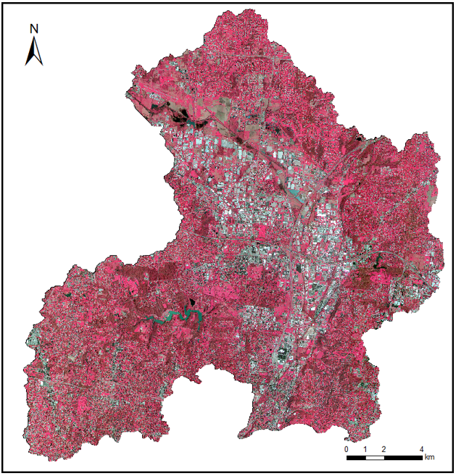
Aerial remote sensing
Introduction
Pros
High spatial resolution
Date can be control
Multi-spectral, LiDAR, Thermal sensor optional
Cons
Expensive
Need pilot and plane
Long repeating cycle
OSIP aerial imagery NIR false color combination at 1 m resolution
Notes:
On the other hand, remote sensing data can obtain an image,
Meanwhile there is a trade-off between spatial and temporal resolution.
For example, Landsat have 30m spatial resolution but 16 day revisiting cycle,
MODIS have daily frequency. But the spatial resolution is relatively low.

Slide 5
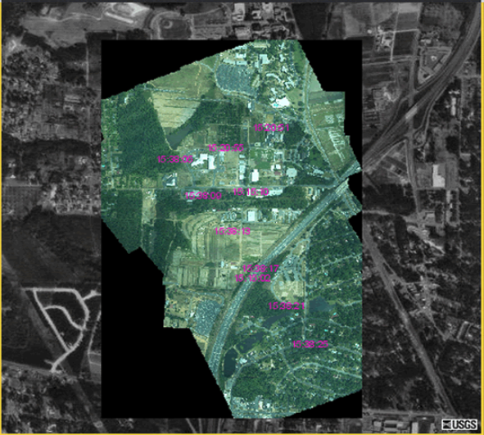
UAV remote sensing
Introduction
Pros
High spatial resolution
Real-time data acquiring
Cheap and convenient
Cons
Accuracy
Image stitching and processing
Data validation
USGS Drone imagery
Notes:
On the other hand, remote sensing data can obtain an image,
Meanwhile there is a trade-off between spatial and temporal resolution.
For example, Landsat have 30m spatial resolution but 16 day revisiting cycle,
MODIS have daily frequency. But the spatial resolution is relatively low.

Slide 6
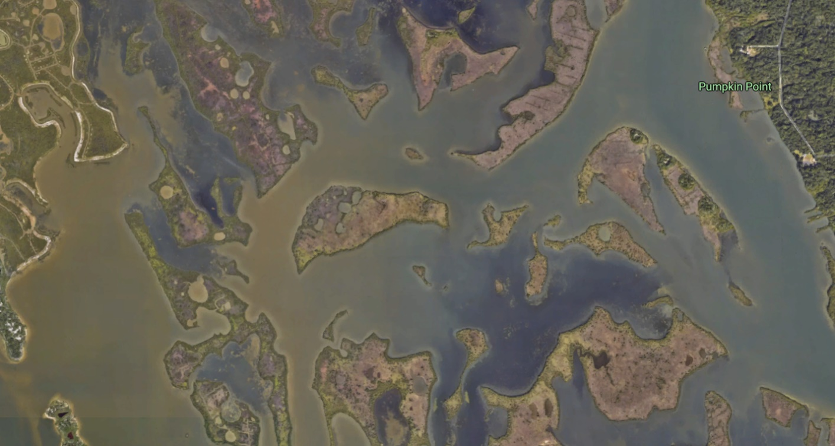

Drone vs. satellite mapping
Introduction
In addition to providing spectacular photos and videos for their aesthetic value, drone imagery can complement satellite imagery to improve scientific analysis and resource management.
Drones have the power to obtain real-time, high-resolution images, as well as footage features.
You can see how the drone image (right) is more clear and up-to-date than the satellite imagery (left).
Notes:
On the other hand, remote sensing data can obtain an image,
Meanwhile there is a trade-off between spatial and temporal resolution.
For example, Landsat have 30m spatial resolution but 16 day revisiting cycle,
MODIS have daily frequency. But the spatial resolution is relatively low.

Slide 7
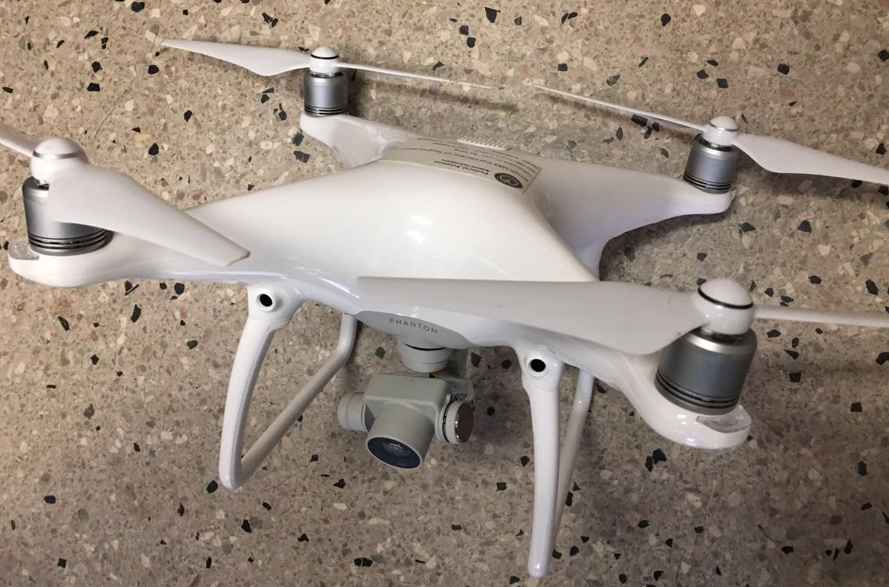
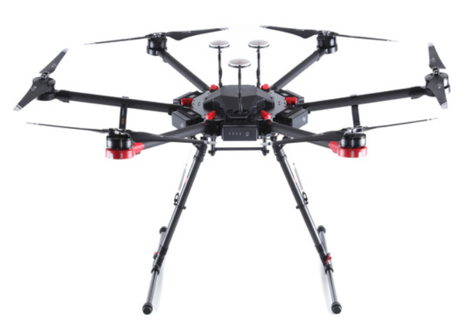
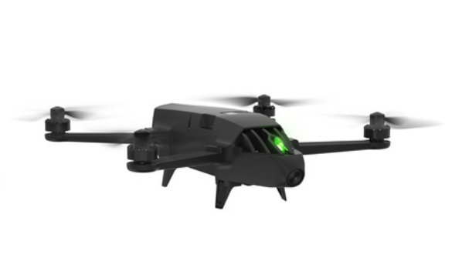
UAVs
Materials
DJI phantom 4 Pro
Parrot Bluegrass
DJI Matrice 600 Pro
Budget: $3000
Fly time: 28 min
Payload: 600g
Budget: $5000
Fly time: 26 min
Payload: 500g
Budget: $8000
Fly time: 42 min
Payload: 1000g

Slide 8
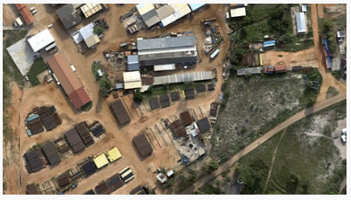
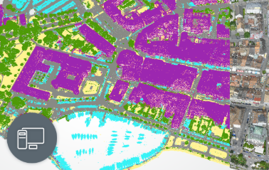
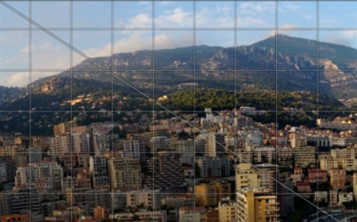
Drone image processing tools
Materials
Esri Drone2Map
Orthomosaic Imagery
Ground Control Points (GCPs)
Elevation products
3D Imagery Products
Pix4D Mapper
Purely from images
Machine-learning algorithm
Point cloud classification
Camera self-calibration
Agisoft PhotoScan
Georeferenced orthomosaic export
Photogrammetric triangulation
Dense point cloud:
editing and classification

Slide 9
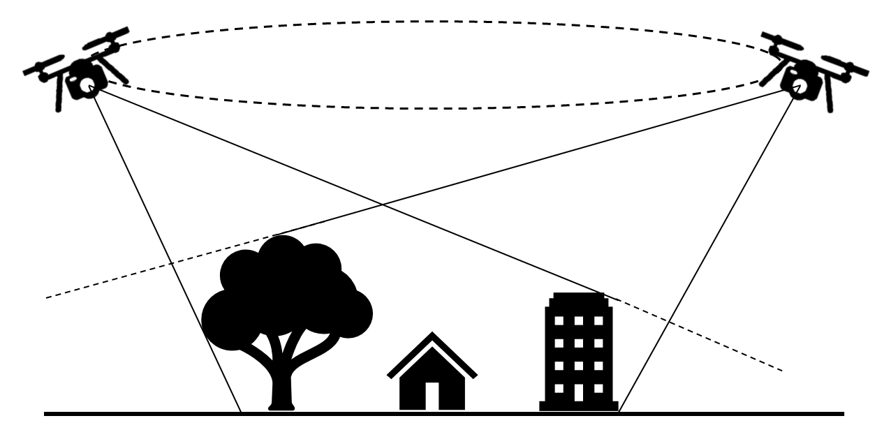
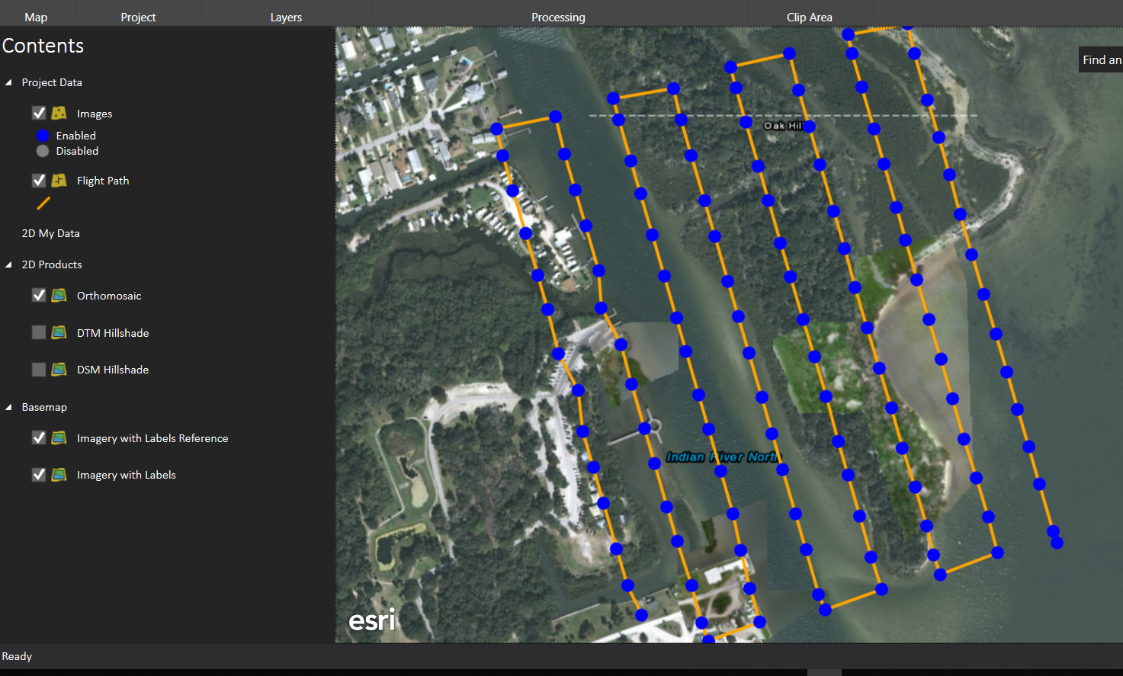
UAV high resolution data
Applications
Flying plan
GCPs and fly path
Notes:
On the other hand, remote sensing data can obtain an image,
Meanwhile there is a trade-off between spatial and temporal resolution.
For example, Landsat have 30m spatial resolution but 16 day revisiting cycle,
MODIS have daily frequency. But the spatial resolution is relatively low.

Slide 10
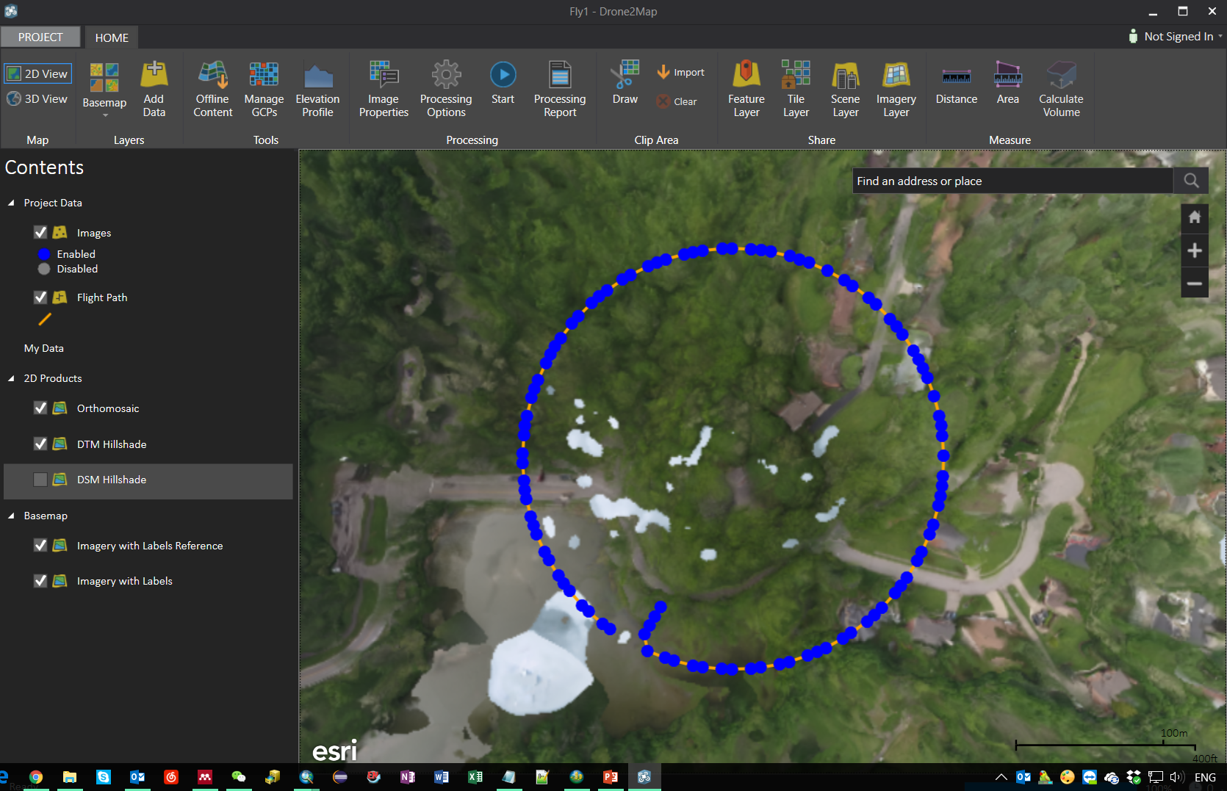
UAV high resolution data
Applications
UAV image stitching and processing - Orthomosaic image
Notes:
On the other hand, remote sensing data can obtain an image,
Meanwhile there is a trade-off between spatial and temporal resolution.
For example, Landsat have 30m spatial resolution but 16 day revisiting cycle,
MODIS have daily frequency. But the spatial resolution is relatively low.

Slide 11
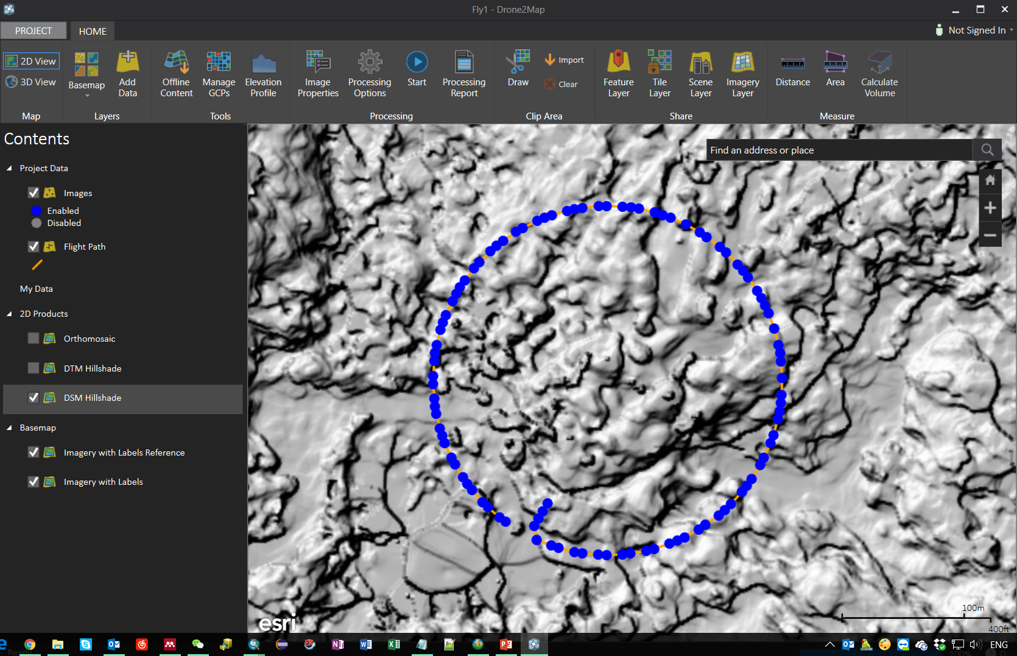
UAV high resolution data
Applications
UAV image stitching and processing - DSM hillshade
Notes:
On the other hand, remote sensing data can obtain an image,
Meanwhile there is a trade-off between spatial and temporal resolution.
For example, Landsat have 30m spatial resolution but 16 day revisiting cycle,
MODIS have daily frequency. But the spatial resolution is relatively low.

Slide 12
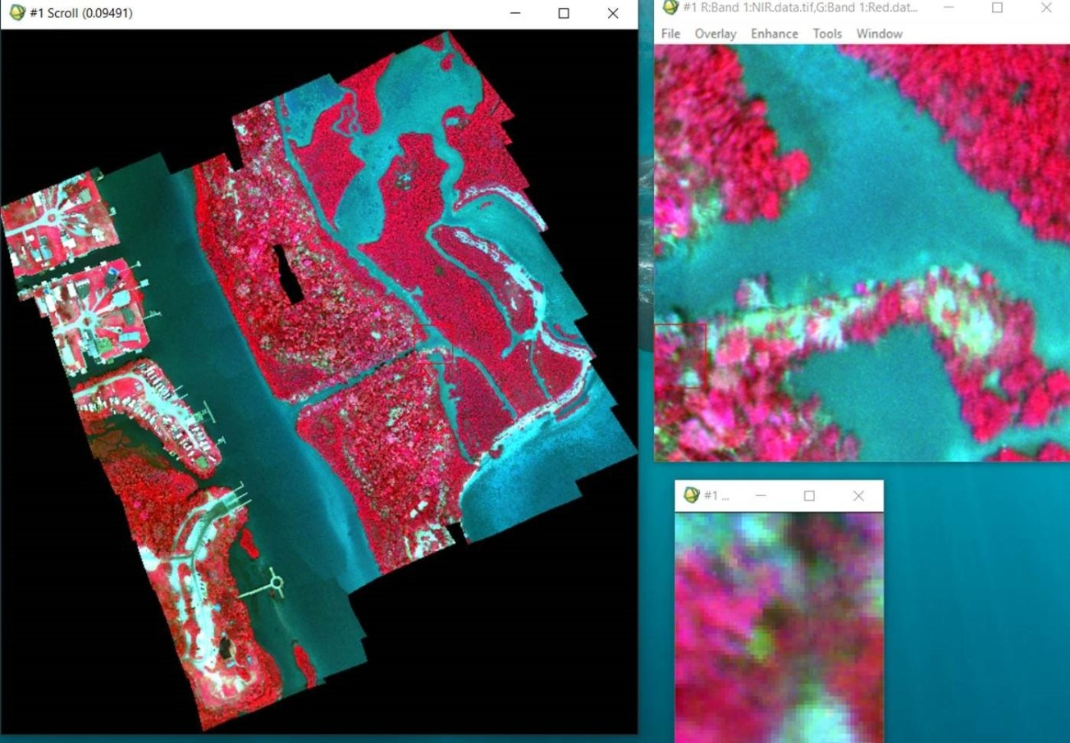
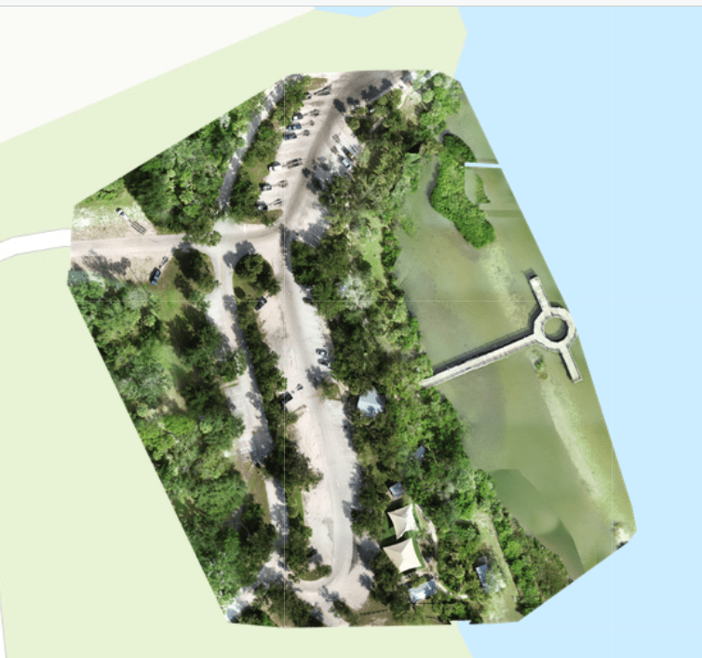
Multi-spectral and RGB data
Applications
Parrot multi-spectral
DJI RGB
Notes:
On the other hand, remote sensing data can obtain an image,
Meanwhile there is a trade-off between spatial and temporal resolution.
For example, Landsat have 30m spatial resolution but 16 day revisiting cycle,
MODIS have daily frequency. But the spatial resolution is relatively low.

Slide 13
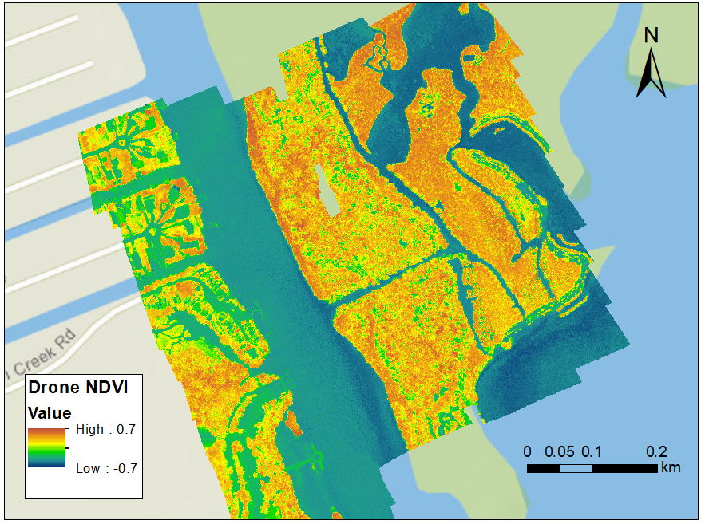
Normalized difference vegetation index (NDVI)
Applications
NDVI could be calculated from the drone mapping imagery.
NDVI is utilized to analyze whether the area contains live green vegetation or not.
water bodies (from −0.0175 to −0.328)
Built environment (−0.019 to 0.060)
bare soil (−0.001 to 0.166).
dense vegetation (0.500 to 0.575)
Notes:
On the other hand, remote sensing data can obtain an image,
Meanwhile there is a trade-off between spatial and temporal resolution.
For example, Landsat have 30m spatial resolution but 16 day revisiting cycle,
MODIS have daily frequency. But the spatial resolution is relatively low.

Slide 14
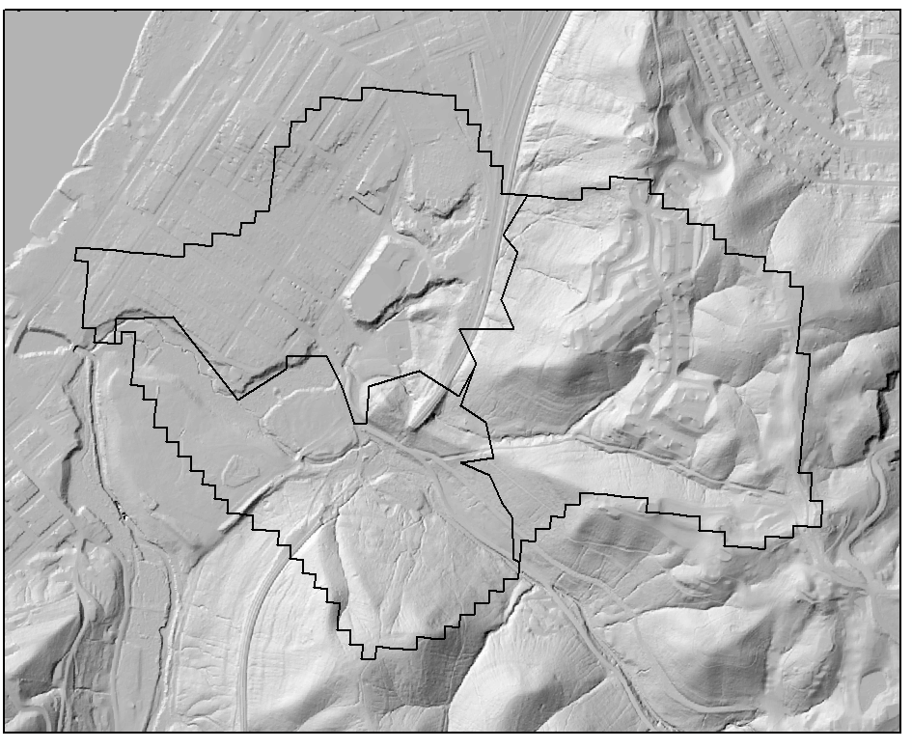
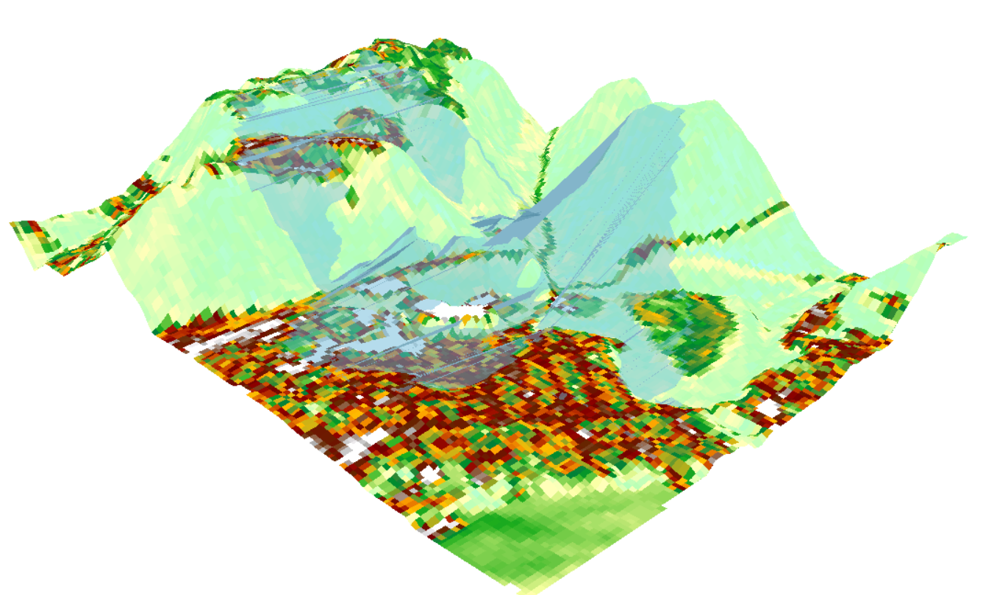
UAV high resolution data
UAV image stitching and processing
DEM hillshade (1 m)
3D View of DEM
Notes:
On the other hand, remote sensing data can obtain an image,
Meanwhile there is a trade-off between spatial and temporal resolution.
For example, Landsat have 30m spatial resolution but 16 day revisiting cycle,
MODIS have daily frequency. But the spatial resolution is relatively low.

Slide 15
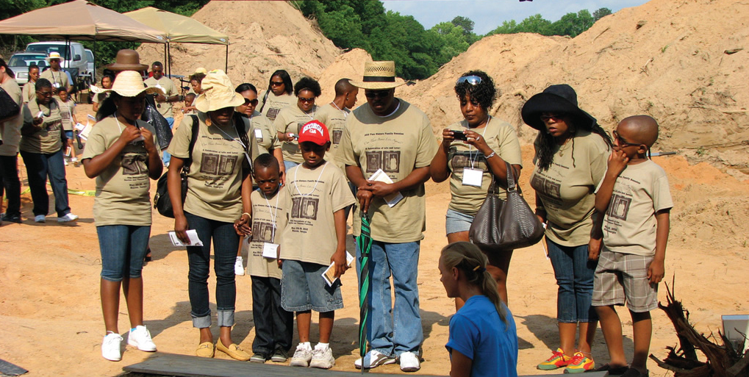
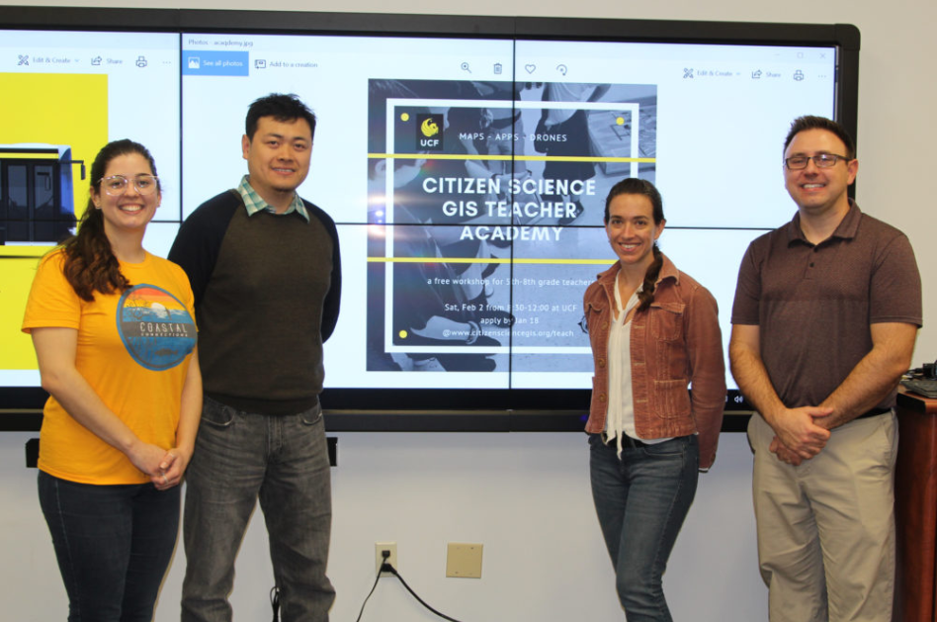

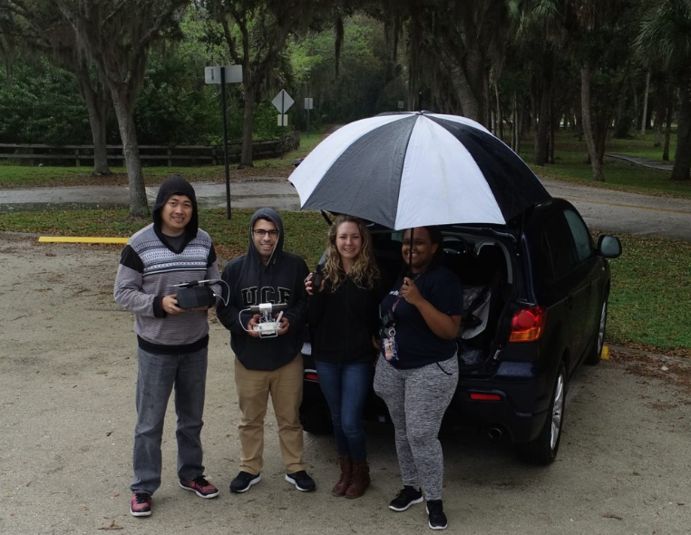
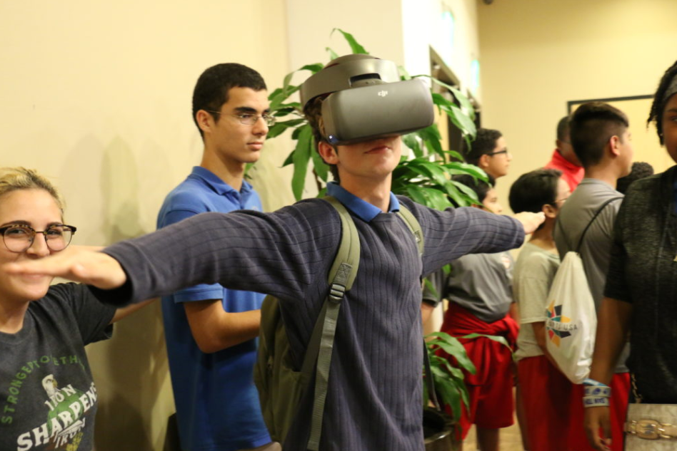
Outreach and community drone projects

Slide 16
Thanks for your attention!
Notes:
Sub AddProgressBar()
On Error Resume Next
With ActivePresentation
For X = 1 To .Slides.Count
.Slides(X).Shapes("PB").Delete
Set s = .Slides(X).Shapes.AddShape(msoShapeRectangle, _
45, .PageSetup.SlideHeight - 57, _
X * .PageSetup.SlideWidth / .Slides.Count - 17, 3)
s.Fill.ForeColor.RGB = RGB(78, 103, 200)
s.Name = "PB"
Next X:
End With
End Sub

